Slide 1
UNlVERSn'Y OF BERGEN
DES™ Physical Defoamer Solution- Eliminate Foam via Physical
Methods after Foam Drainage Gas Production
Originated From Norway University of Bergen Intelligence
SYNERGY OILFIELD TECHNOLOGY SERVICE Co.
Ltd.
Copyright © 2022 SYNERGY OILFIELD TECHNOLOGY SERVICE Co. Ltd. All rights reserved.
SYNERGY
OILFIELD SERVICE

Slide 2
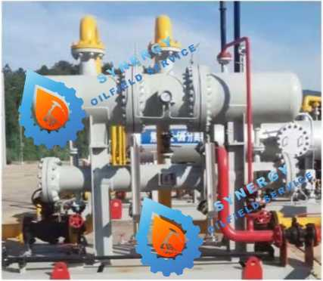

TECHNICAL BULLETING
SYNERGY SOLUTIONS
DF.S™ Physical Defoamer Solution- Eliminate Foam via Physical
Methods after Foam Drainage Gas Production
Physical defoaming replaces chemical defoaming, abandons chemical defoaming agent
DF.S™ System
1. Originated From Norway University of Bergen Intelligence;
2. Revolutionary physical defoaming technology, completely replace the traditional chemical defoaming way, completely abandon the use of chemical defoaming agent;
3. Physical anti-foaming, no foam will be generated in the back-end process after defoaming;
4. The negative effects of foam in the production process, pipeline and other parts are completely solved by physical means;
5. The pollution risk of triethylene glycol caused by the poor effect of chemical defoaming and antifoaming is completely solved by physical means;
6. Environmental friendly, and greatly reduce the cost.
DF.S™ Source
1. Three Phase separation Technology, University of BERGEN, Norway, awarded by Royal Dutch Shell;
2. Three phase separation theory and technology of physical defoaming system, has published more than 50 papers in ELSEVIER and other journals;
3. The three-phase separation theory and technology of physical defoaming system has obtained more than 30 invention patents at home and abroad.
4. In 2022, SYNERGY & University of BERGEN experts jointly developed physical defoaming system suitable for unconventional gas fields in China.
DF.S™ Benefits
1. Separation of solid dust, droplets, fog droplets, foam, separation efficiency is greater than 99%;
2. The atomizer of the through-type separator can capture nanometer droplets well.
3. Completely replace the traditional chemical defoaming method;
4. With antifoaming function, it also has effective physical antifoaming function;
5. The installation of the equipment is simple. Generally, a set of systems can be installed in the gas collecting station to achieve the effect of physical defoaming;
6. Parameters can be customized according to actual gas production, pressure, foam volume, etc.
7. Greatly reduce the cost of defoaming agent and reduce chemical pollution;
8. Reduce the frequency of pigging;
9. Mitigate the risk of pipeline fluid accumulation;
10. No external energy;
SYNERGY
OILFIELD SERVICE
UNIVERSITY OF BERGEN
SYNERGY OILFIELD TECHNOLOGY SERVICE Co. Ltd.
http://www.synergy-service.cn

Slide 3
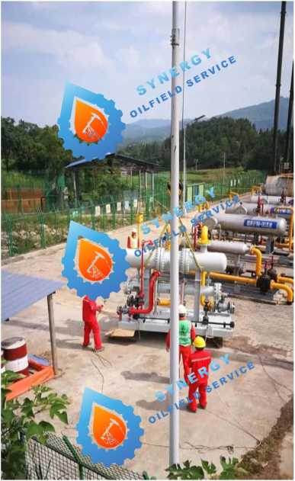
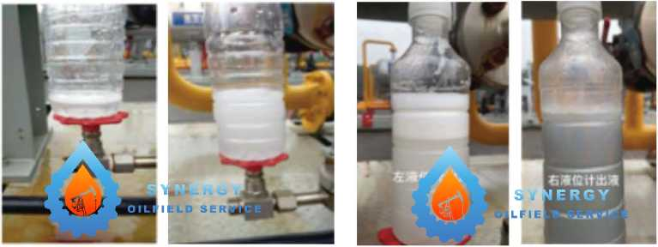
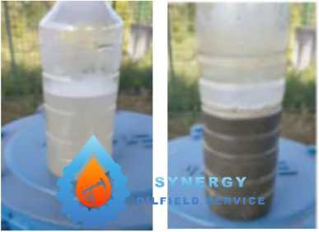


DF.S™Case Study in Southern Shale China
On the basis of laboratory experiments, a prototype suitable for this shale gas field was customized in 2021, and the XXXX platform with high gas production, large liquid production and poor antifoaming effect (the ratio of foaming agent to antifoaming agent reached 1:3) was selected for field tests, and the field adaptability of this technology was studied.
Field test by 4 months, foaming agent and foam agent proportion from previous 1:3 adjustment to a 1-0. 5, under the condition of not change the dosage of foaming agent, dosage of defoaming agent have fallen sharply, drainage system, compared to the amount of upfront with coalescing filter an increase of 100 kilograms, and liquid crystal without bubble, bubble elimination rate is greater than 99%, at the same time also can efficiently isolate nanoscale droplets. The effect of physical defoaming system is completely verified.
DF.S™ Case Study in Southern Shale China
Three groups of comparison experiments, the liquid separated from the physical defoaming system and its color:
1. The container on the right of the physical defoaming system separates more liquid than the liquid on the left;
2. The right side is more cloudy, indicating that the right side of the centrifugal foaming and separation effect is good;
3. The physical defoaming system can also capture nano-level fog droplets well in the defogger of the th rough-type separator.
1st Sample
2nd Sample
3th Sample
SYNERGY
OILFIELD SERVICE
UNIVERSITY OF BERGEN
SYNERGY OILFIELD TECHNOLOGY SERVICE Co. Ltd.
htt p://www. synergy-service.cn

Slide 4


DON'T JUST DEVELOP YOUR WELL DF.S™ IT.
FOR MORE ON THE DF.S™ SYSTEM, OR OTHER INFO, PLEASE CONTACT WITH SYNERGY OILFIELD TECHNOLOGY SERVICE Co. Ltd.
Keep In Touch:
Email: wujia@synergy-service.cn
Tel: 0086 18881776777
SYNERGY
OILFIELD SERVICE
UNIVERSITY OF BERGEN

